Slide 1


Java project
Rental Car
AMAR Sacha
KOSSI KANA Marilyn Baudoin

Slide 2
Summary
Class diagram
Database design
GUI
Evaluation of the project
Bibliography

Slide 3
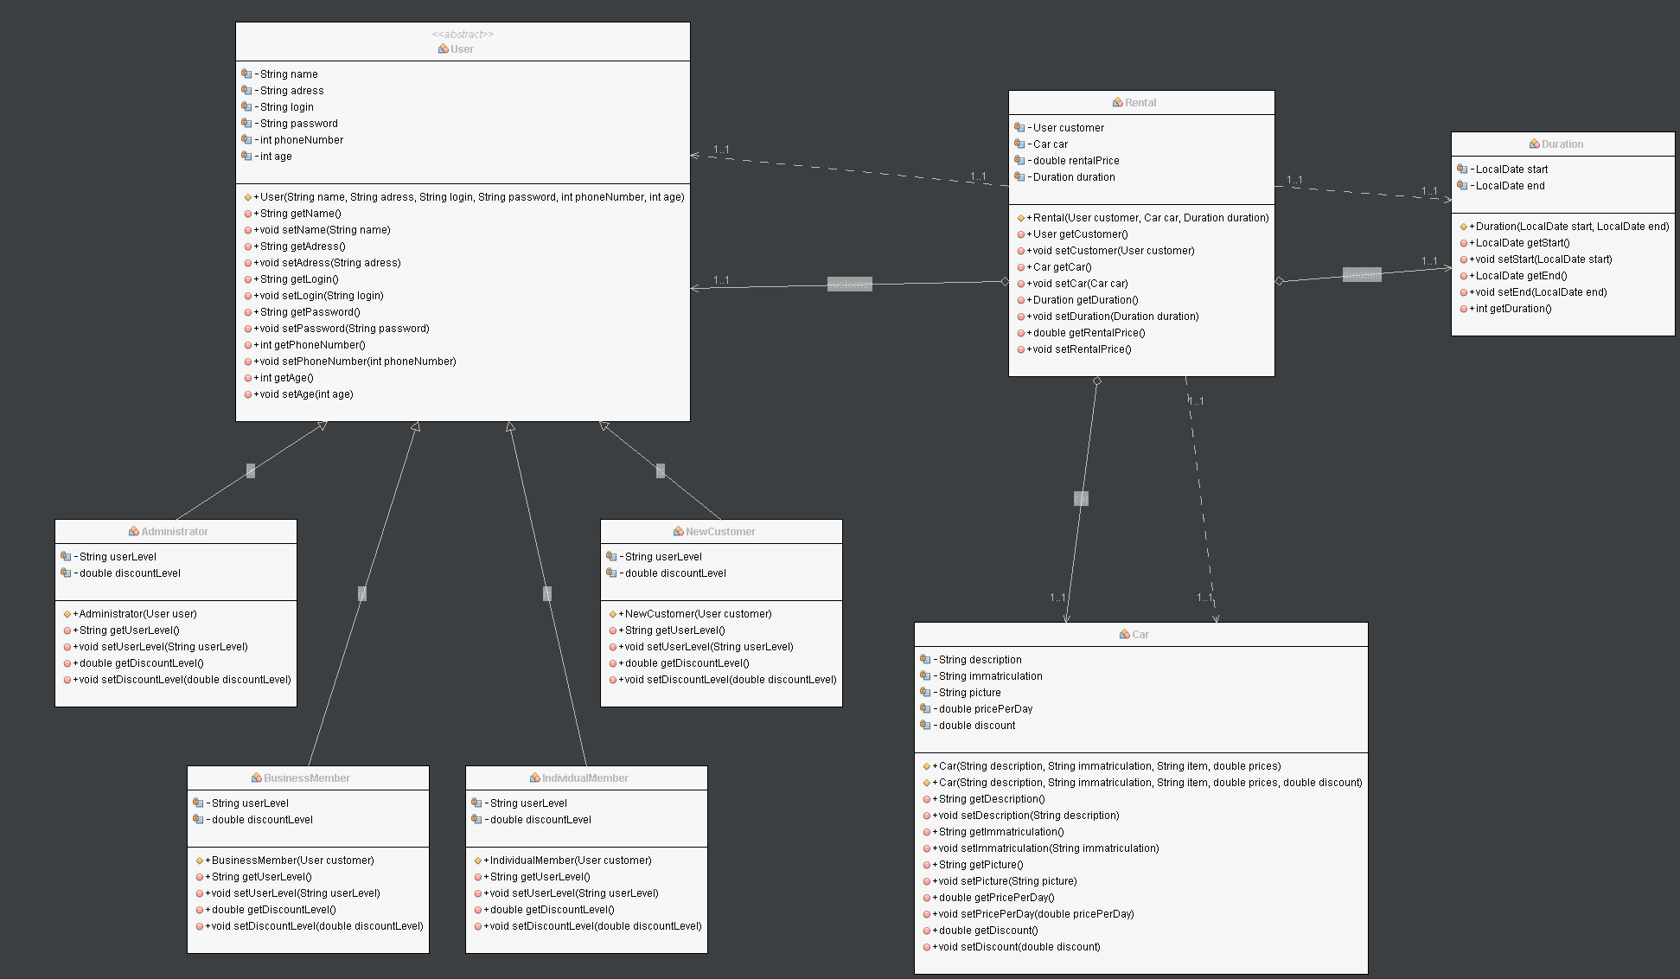
Class diagram

Slide 4
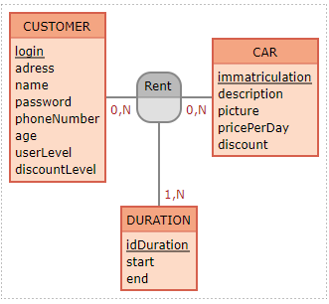
Database design

Slide 5
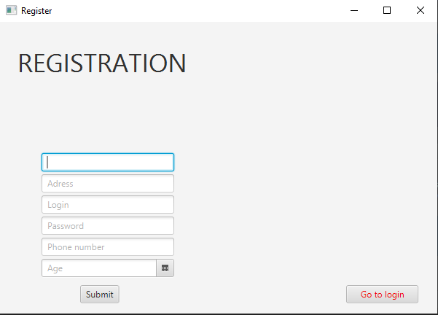
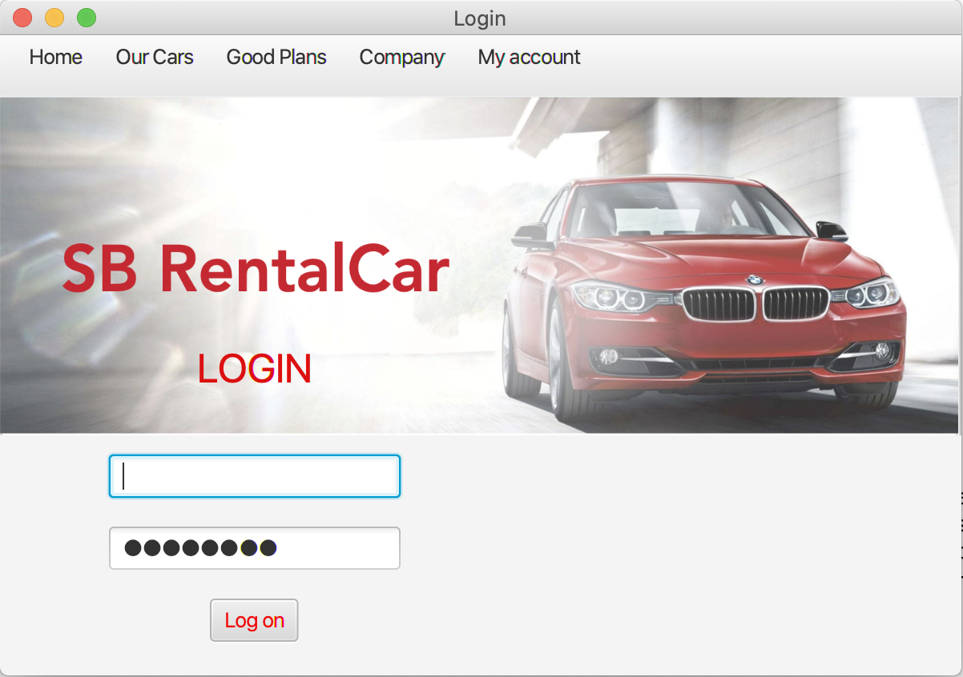
GUI
Registration :
Login :

Slide 6
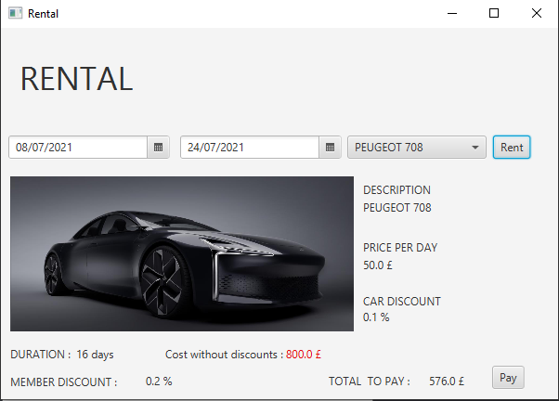
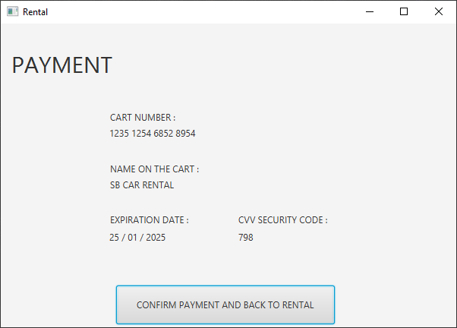
GUI
Rental :
Payment :

Slide 7
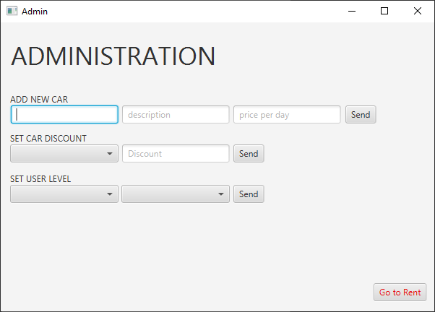
GUI
Administration :

Slide 8
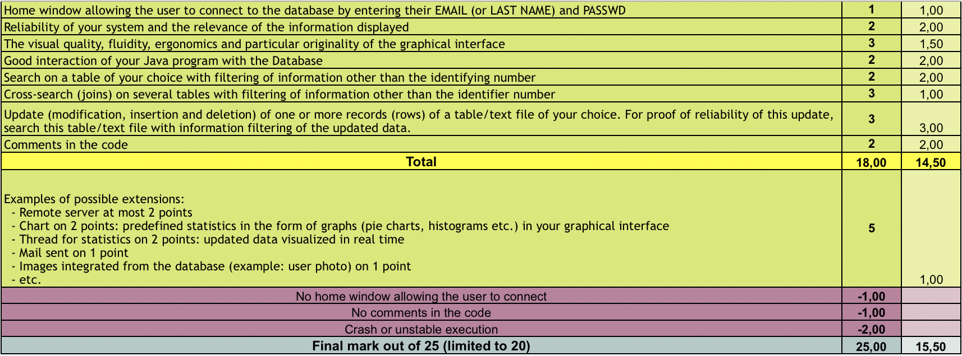
Our own evaluation of the project

Slide 9
Bibliography
Database (SQL) :
https://www.jmdoudoux.fr/java/dej/chap-jpa.htm
https://openclassrooms.com/fr/courses/626954-creez-votre-application-web-avec-java-ee/625580-la-persistance-des-donnees-avec-jpa
JavaFX: https://stackoverflow.com/questions/15041760/javafx-open-new-window | https://openjfx.io/ | https://openclassrooms.com/fr/courses/26832-apprenez-a-programmer-en-java/5014486-decouvrez-java-fx

Slide 10
Thank you for your attention

